Slide 1
NSA Grade III Performance Evaluation

Slide 2
Performance Analysis
National Level Performance
State Level Performance
Language Level Performance
Conclusion

Slide 3
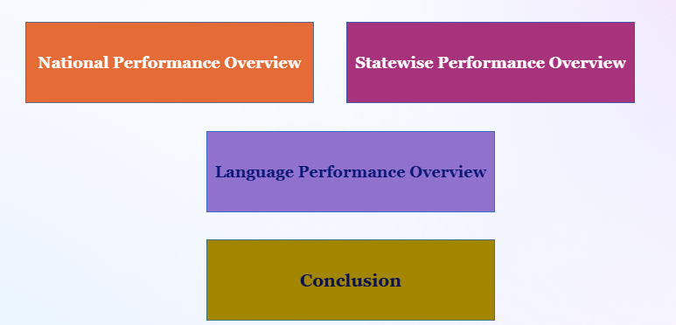
Students Performance
Analysis comprises of data Year wise, Category wise, State/Zone wise & based on languages
The analysis covers Grade 3 Performances at the state and National level

Slide 4
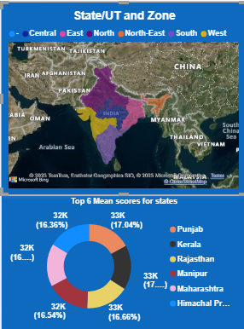
State Wise Performance
States with lower averages need additional support
Punjab, Kerala And Rajasthan Are top performing States whereas Meghalaya, Arunachal Pradesh and Ladakh are last three in the list respectively
Zone wise area performance

Slide 5
Coclusion
Monitor Progress Quarterly
Low Performing State to be Monitored and Reviewed for performance Analysis Frequently
Language Based performance to be scrrutinized
Seek feedback
Reflect on performance
Explore new techniques
Set personal goals
Iterate and adapt

